Slide 1

Deep Learning – Certification Program
Code Assignment – Module 4
Phone : +91 9742800566
Offices : Bengaluru
Email : contact@cellstrat.com
Web : www.cellstrat.com
CellStrat™ Confidential. All Rights Reserved.

Slide 2
Module 4 (Set 1 code)
How to train an ANN

Slide 3

Questions
What is the difference between Perceptron Learning Rule and Adaline Rule ?
Notes:
Merge Sort?

Slide 4
Questions
2) If the two classes in a dataset have a non-linear classifier boundary, then how to prevent the model from executing infinite training steps?
Notes:
Merge Sort?

Slide 5
Questions
module4_credit_dnn.ipynb
3) The accuracy with 5000 iterations and three hidden layers is 70-80% approx. ? How can you improve this ?
Notes:
Merge Sort?

Slide 6
Module 4 (Set 2 code)

Slide 7
Questions
Module4_Ex1.ipynb
1) Looking at Training Cost vs the Epoch plot in the code provided, what is the optimum no of Epochs and why ?
Notes:
Merge Sort?

Slide 8
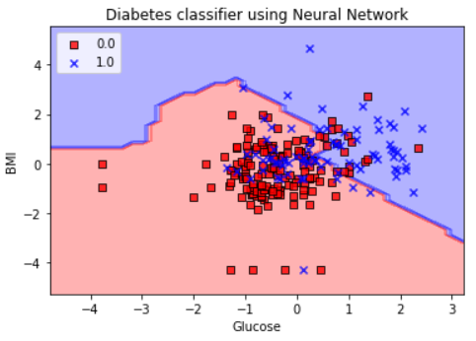
Questions
module4_pima_single_layer_dnn_tf.ipynb
2) Interpret the output plot shown ?
Notes:
Merge Sort?

Slide 9
Questions
module4_pima_single_layer_dnn_tf.ipynb
3) Run the model once as provided. Then increase the no of layers in DNNClassifier to three layers (lets say with 5, 10, 5 neurons). Run the model again. What happens and why ?
Notes:
Merge Sort?

Slide 10
Questions
module4_pima_single_layer_dnn_tf.ipynb
4) How can you fix the problem in the prior question ? What happens when you fix it ? What is the interpretation of output plot after you try with three hidden layers ?
Notes:
Merge Sort?

